Slide 1
The Prophesies Given to Daniel: A Historical Perspective

Slide 2
As we discuss these things
Don’t worry about memorizing/remembering dates.
Focus on the bigger messages and lessons.

Slide 3
From Daniel Chapter 2:
24 Therefore Daniel went to Arioch, whom the king had appointed to destroy the wise men of Babylon. He went and said thus to him: “Do not destroy the wise men of Babylon; take me before the king, and I will tell the king the interpretation.” 25 Then Arioch quickly brought Daniel before the king, and said thus to him, “I have found a man of the captives of Judah, who will make known to the king the interpretation.” 26 The king answered and said to Daniel, whose name was Belteshazzar, “Are you able to make known to me the dream which I have seen, and its interpretation?”

Slide 4
27 Daniel answered in the presence of the king, and said, “The secret which the king has demanded, the wise men, the astrologers, the magicians, and the soothsayers cannot declare to the king. 28 But there is a God in heaven who reveals secrets, and He has made known to King Nebuchadnezzar what will be in the latter days. Your dream, and the visions of your head upon your bed, were these: 29 As for you, O king, thoughts came to your mind while on your bed, about what would come to pass after this; and He who reveals secrets has made known to you what will be. 30 But as for me, this secret has not been revealed to me because I have more wisdom than anyone living, but for our sakes who make known the interpretation to the king, and that you may know the thoughts of your heart.

Slide 5
31 “You, O king, were watching; and behold, a great image! This great image, whose splendor was excellent, stood before you; and its form was awesome. 32 This image’s head was of fine gold, its chest and arms of silver, its belly and thighs of bronze, 33 its legs of iron, its feet partly of iron and partly of clay. 34 You watched while a stone was cut out without hands, which struck the image on its feet of iron and clay and broke them in pieces. 35 Then the iron, the clay, the bronze, the silver, and the gold were crushed together, and became like chaff from the summer threshing floors; the wind carried them away so that no trace of them was found. And the stone that struck the image became a great mountain and filled the whole earth.

Slide 6
36 “This is the dream. Now we will tell the interpretation of it before the king. 37 You, O king, are a king of kings. For the God of heaven has given you a kingdom, power, strength, and glory; 38 and wherever the children of men dwell, or the beasts of the field and the birds of the heaven, He has given them into your hand, and has made you ruler over them all—you are this head of gold. 39 But after you shall arise another kingdom inferior to yours; then another, a third kingdom of bronze, which shall rule over all the earth. 40 And the fourth kingdom shall be as strong as iron, inasmuch as iron breaks in pieces and shatters everything; and like iron that crushes, that kingdom will break in pieces and crush all the others.

Slide 7
41 Whereas you saw the feet and toes, partly of potter’s clay and partly of iron, the kingdom shall be divided; yet the strength of the iron shall be in it, just as you saw the iron mixed with ceramic clay. 42 And as the toes of the feet were partly of iron and partly of clay, so the kingdom shall be partly strong and partly fragile. 43 As you saw iron mixed with ceramic clay, they will mingle with the seed of men; but they will not adhere to one another, just as iron does not mix with clay. 44 And in the days of these kings the God of heaven will set up a kingdom which shall never be destroyed; and the kingdom shall not be left to other people; it shall break in pieces and consume all these kingdoms, and it shall stand forever.

Slide 8
45 Inasmuch as you saw that the stone was cut out of the mountain without hands, and that it broke in pieces the iron, the bronze, the clay, the silver, and the gold—the great God has made known to the king what will come to pass after this. The dream is certain, and its interpretation is sure.”
46 Then King Nebuchadnezzar fell on his face, prostrate before Daniel, and commanded that they should present an offering and incense to him. 47 The king answered Daniel, and said, “Truly your God is the God of gods, the Lord of kings, and a revealer of secrets, since you could reveal this secret.”

Slide 9
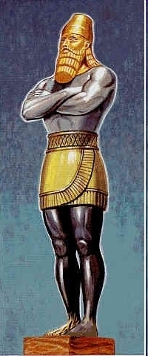
What Kingdoms?
Head of Gold: Babylon (modern Iraq)
Chest of Silver: Media-Persia (modern Iran)
Belly-thighs brass: Alexander and the Greek empire (short-lived, as prophesied)
Legs of Iron: The split Greek empire
Feet of Iron & Clay: Rome
The Huge Cut Stone: Christ’s Kingdom

Slide 10
Other beliefs about the huge cut stone:
Jews: An eternal Jewish kingdom (confirmed by Josephus)
Mormons: Establishment of the “Latter Day Saints”
Muslims: Establishment of Islam
Premillennialists: That the new kingdom is from Jesus, but…
And so on. And so on.

Slide 11
Here are the actual dates:

Slide 12
870 BC Rise of Assyria
727 BC Tiglath-Pilezar conquers Israel (but not Judah!)
612 BC Nineveh (Assyria) falls to Babylon
605 BC Battle of Carchemish (final fall of Assyria to Nebuchadnezzar)
586 BC Jerusalem falls, temple destroyed, second captivity begins
539 BC Cyrus takes Babylon; rise of Media-Persian empire.
486-465 Xerxes I (grandson of Cyrus, husband of Esther)
331 BC Battle of Megapolis, Rise of Alexander and Greek Empire
323 BC Death of Alexander, Greek empire divided into quarters
167-160 Maccabean Rebellion (Israel self-rule)
63 BC Rome (Pompey) “helps” Jerusalem

Slide 13
Cyrus the Great Conquers Babylon (About 46 years later)
Daniel 5:1 Belshazzar the king made a great feast for a thousand of his lords and drank wine in the presence of the thousand. 2 While he tasted the wine, Belshazzar gave the command to bring the gold and silver vessels which his father Nebuchadnezzar had taken from the temple which had been in Jerusalem, that the king and his lords, his wives, and his concubines might drink from them. 3 Then they brought the gold vessels that had been taken from the temple of the house of God which had been in Jerusalem; and the king and his lords, his wives, and his concubines drank from them. 4 They drank wine, and praised the gods of gold and silver, bronze and iron, wood and stone.

Slide 14
5 In the same hour the fingers of a man’s hand appeared and wrote opposite the lampstand on the plaster of the wall of the king’s palace; and the king saw the part of the hand that wrote. 6 Then the king’s countenance changed, and his thoughts troubled him, so that the joints of his hips were loosened and his knees knocked against each other. 7 The king cried aloud to bring in the astrologers, the Chaldeans, and the soothsayers. The king spoke, saying to the wise men of Babylon, “Whoever reads this writing, and tells me its interpretation, shall be clothed with purple and have a chain of gold around his neck; and he shall be the third ruler in the kingdom.” 8 Now all the king’s wise men came, but they could not read the writing, or make known to the king its interpretation.

Slide 15
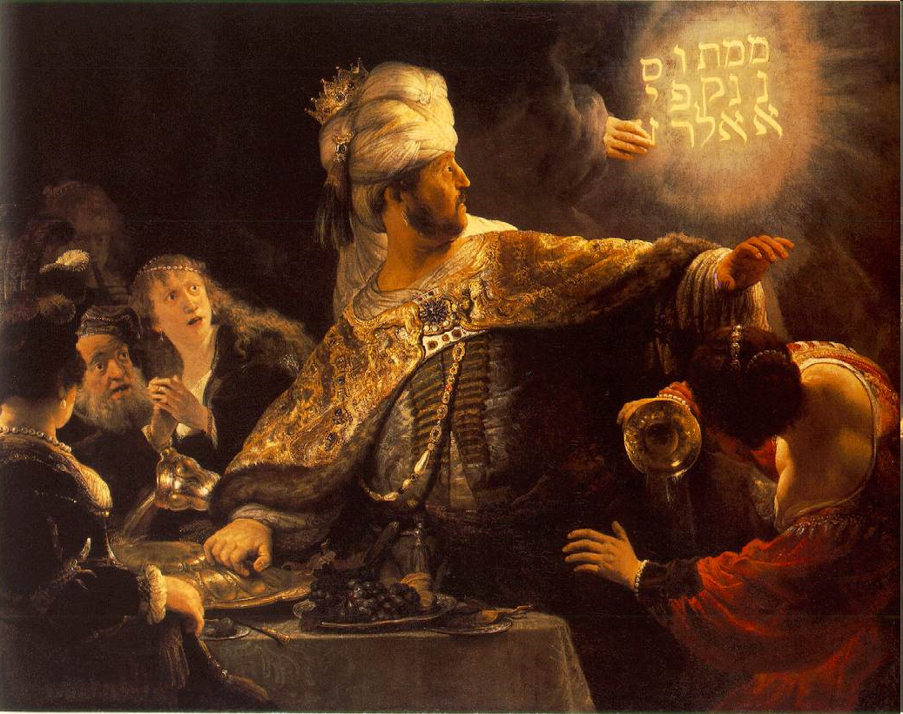
“Yikes!”
Note knocking knees…

Slide 16
22 “But you his [grand]son, Belshazzar, have not humbled your heart, although you knew all this. 23 And you have lifted yourself up against the Lord of heaven. They have brought the vessels of His house before you, and you and your lords, your wives and your concubines, have drunk wine from them. And you have praised the gods of silver and gold, bronze and iron, wood and stone, which do not see or hear or know; and the God who holds your breath in His hand and owns all your ways, you have not glorified. 24 Then the fingers of the hand were sent from Him, and this writing was written.
25 “And this is the inscription that was written:
MENE, MENE, TEKEL, UPHARSIN. [Daniel quotes the Jewish nouns.]
26 This is the interpretation of each word. MENE: God has numbered your kingdom and finished it; 27 TEKEL: You have been weighed in the balances and found wanting; 28 PERES: Your kingdom has been divided and given to the Medes and Persians.”

Slide 17
The messages in all of Daniel’s Prophesies:
God, not men, determines the rise and fall of rulers and governments
God raises rulers and nations for His purposes
God judges nations and rulers. He may choose to humble them, as he did with Nebuchadnezzar’s later pride.
God would establish an eternal kingdom that encompassed all and would not be superseded. And it was founded on the day of Pentecost, exactly as God planned.

Slide 18
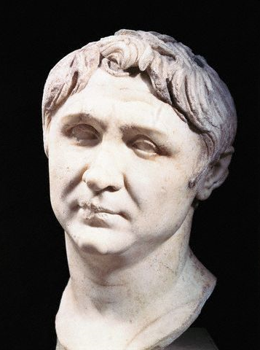
Roman Rule: Pompey Takes Jerusalem (63 BC)
The Jews (who had overthrown Greek rule) were now in a civil war between two factions and were being pressured by Syrian Greece
Both factions paid Pompey to come to their aid
A Roman-Jewish army of Pompey & Hyrcanus II took Jerusalem after 3 months
Pompey entered the Holy of Holies to satisfy his own curiosity (!)
Roman domination of Israel begins
Jerusalem destroyed 103 years later (70 AD)

Slide 19
The important messages in Daniel’s Prophesies:
Daniel said to every King that asked, “These prophesies are from God- not me.” (Nebuchadnezzar, Belshazzar & Cyrus)
God has a plan. (Might be a good idea to pay attention.)
God determines the rise and fall of rulers and governments
God judges nations and he judges its rulers. See Jeremiah, Ezekiel and other prophets.
Each kingdom was planned in order to establish an eternal kingdom that crosses all borders, and all governments

Slide 20
God’s Eternal Purpose:
Daniel 2:44 “And in the days of these kings the God of heaven will set up a kingdom which shall never be destroyed; and the kingdom shall not be left to other people; it shall break in pieces and consume all these kingdoms, and it shall stand forever.”

Slide 21
A few observations as we conclude...
God had begun His work on this LONG before Daniel.
Just as Babylon, Media-Persia, Greece and Rome were temporary steps that led to the Kingdom, so was Judaism and the Old Law. (See Hebrews, Galatians, Romans, I Corinthians.)
God’s plan from the beginning was to send His only Son to save us from our own foolishness!
What did Jesus say at the beginning of His ministry? “Repent- for the Kingdom of Heaven is at hand!” (Matthew 3:2)

Slide 22
God’s eternal plan is designed to include YOU.
How do you think that God looks upon:
Indifference? (Consider the parable of the great feast)
Disrespect? (Consider the parable of the vineyard owner)
Turn to God. He is always there waiting for us to come to our senses, repent and turn to Him (as with the prodigal son).
Nebuchadnezzar, Naaman, Cyrus and many other “powerful” men came to realize who God really is and said so. Shouldn’t you?

